Slide 1
Duct system design
Designing duct systems of duct runs

Slide 2
Duct System Design Overview
Evaluate system and calculate CFM draw of each system (covered in “CFM Calculations” PowerPoint)
Choose a collector based off of the application we are cleaning
Choose an A:C ratio if we are pulling a dust application (Avani/ACT)
Choose proper Absolent machine if oil mist/smoke
Choose collector location (based off of onsite visit)
Run duct to drops, tapering duct in main duct run
Keep static pressure to a minimum

Slide 3
Choosing the Proper Dust Collector
All dust collectors contain filters, which are used to filter the air
Dust collectors are sized by using an Air to Cloth ratio
Air = Total CFM of the System
Cloth = Total Surface Area of Filters in the Collector
Avani filters = 205 ft2 per filter
ACT filters = 254 ft2 per filter
Avani has sold collectors ranging from 4:1 to 0.5:1
4:1 – used in welding schools or other part-time welding facilities
3:1 – most common in fabrication facilities
2:1 – Robotic welding cells
0.5:1 – Plasma Dust
Example: Avani is quoting a dust collector to pick up six 6” fume arms inside a welding school. Please (a) size the fan CFM needed for this install, (b) pick the correct A:C ratio, (c) calculate the minimal filters needed for the ACT collector, (d) choose the correct ACT collector, and (e) calculate the exact A:C ratio based off of the collector we have picked out

Slide 4
Choosing the Proper Dust Collector - Example
Size the fan CFM needed for this install
CFM_{total} = (6) * CFM_{6” Fume Arms}
CFM_{total} = (6) * 800 CFM
CFM_{total} = 4800 CFM
Pick the correct A:C ratio
A:C ratio of welding facilities = 4:1
4800:Cloth = 4:1
Cloth = 1200 ft²
Calculate the minimal filters needed for the ACT collector
Minimum Cloth Required = 1200 ft²
Using the ACT chart, next largest filter area is 1,524 ft²
Choose the correct ACT collector
Using the ACT chart, next largest filter area is the ACT-3-6
Calculate the exact A:C ratio based off of the collector we have picked out
1,524 ft2 is our new cloth ratio
4,800 CFM is the total CFM in the System
4,800:1,524 = Air:1
New Air:Cloth = 3.14:1

Slide 5
Choosing the Proper Absolent
Absolent has 3 models we sell. We size Absolent units by the aerosol count in the air.
A-Mist Series (formerly called ODF)
If Aerosol count is between 0-15, use A-Mist
Typically used with water based coolant sprayed at low pressure
If count is between 15-25, one can install special filters referred to as s-filters. If s-filters are installed, the CFM for the collector will be cut in half.
A-Smoke Series (formerly called ODR)
If Aerosol count is 25 or greater, use A-Smoke
Typically used with oil based coolant or coolant sprayed at high pressure

Slide 6
List of Absolent Units
 | Old | New | CFM | Height (H) | Width (W) | Depth (D) | Inlet Duct
ODF | ODF 800 | A mist^{6C} | 355 cfm | 39.4 in | 24.4 in | 11.8 in | 4.9 in
 | ODF 1000 | A mist¹⁰ | 590 cfm | 61.2 in | 24.4 in | 24.4 in | 6.3 in
 | ODF 2000 | A mist²⁰ | 1180 cfm | 81.1 in | 24.4 in | 24.4 in | 7.8 in
 | ODF 4000T | A mist^{40T} | 2350 cfm | 71.6 in | 28.5 in | 49.7 in | 12.4 in
 | ODF 4000TF | A mist^{40TF} | 2350 cfm | 92.9 in | 28.5 in | 49.9 in | 12.4 in
 | ODF 6000 | A mist⁶⁰ | 3530 cfm | 89.6 in | 83.5 in | 24.4 in | 15.7 in
 | ODF 8000 | A mist^{80T} | 4700 cfm | 81.4 in | 55.7 in | 49.8 in | 15.7 in
 | ODF 8000TF | A mist^{80TF} | 4700 cfm | 106.7 in | 55.7 in | 49.8 in | 15.7 in
ODR | ODR 2000 | A smoke²⁰ | 1180 cfm | 93.3 in | 29.1 in | 30.7 in | 7.8 in
 | ODR 3000 | A smoke⁴⁰ | 2350 cfm | 139.0 in | 43.8 in | 46.0 in | 12.4 in
 | ODR 6000T | A smoke^{80T} | 4700 cfm | 115.7 in | 45.4 in | 83.3 in | 15.7 in
 | ODR 9000 | A smoke¹²⁰ | 7050 cfm | 145.2 in | 131.2 in | 45.3 in | 19.7 in
 | ODR 12000T | A smoke^{160T} | 9400 cfm | 131.8 in | 89.2 in | 85.5 in | 25.0 in
 |  | A mist^{10C} | 590 cfm | 31.8 in | 42.4 in | 27.0 in | 6.3 in

Slide 7
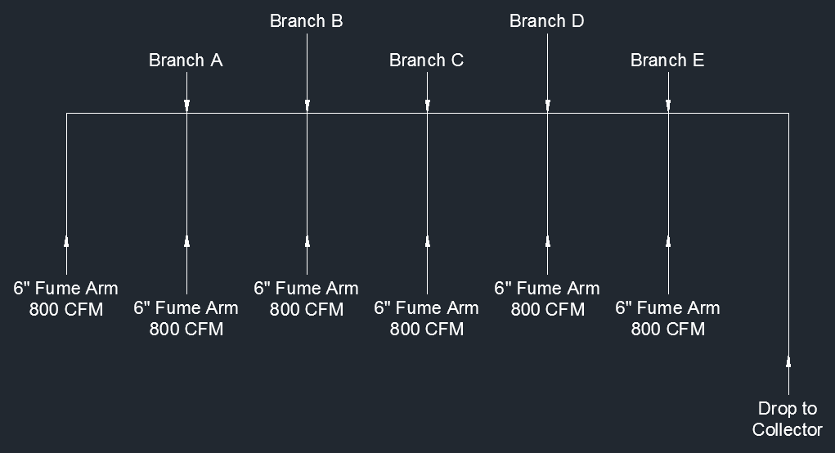
Sizing Duct Layouts
Determine CFM draw
Determine FPM flow from application
Create initial layout with pickup locations and collector location
Size duct and main duct run based off of CFM draw at that point in the pipe.
Example: Design the duct layout for the six 6” fume arms we chose a collector for earlier. Assume the fume arms are in one row.

Slide 8
Sizing Duct Layout Example 1 – Branch A
CFM_{Branch A} = 800CFM + 800CFM
CFM_{Branch A} = 1600CFM
FPM_{Welding Smoke} = 3500FPM
CFM=FPM*SA
1600 CFM = 3500FPM * SA
1600/3500 = SA = .457ft²
.457ft² is closest to .4418ft² = 9” duct
Branch A is 9”x6”x6”

Slide 9
Sizing Duct Layout Example 1 – Branch B
CFM_{Branch B} = 1600CFM + 800CFM
CFM_{Branch B} = 2400CFM
FPM_{Welding Smoke} = 3500FPM
CFM=FPM*SA
2400 CFM = 3500FPM * SA
2400/3500 = SA = .686ft²
.686ft² is closes to .785ft² = 12” duct
Branch B is 12”x9”x6”

Slide 10
Sizing Duct Layout Example 1 – Branch C
CFM_{Branch C} = 2400CFM + 800CFM
CFM_{Branch C} = 3200CFM
FPM_{Welding Smoke} = 3500FPM
CFM=FPM*SA
3200 CFM = 3500FPM * SA
3200/3500 = SA = .914ft²
.914ft² is closes to 1.07ft² = 14” duct
Branch C is 14”x12”x6”

Slide 11
Sizing Duct Layout Example 1 – Branch D
CFM_{Branch D} = 3200CFM + 800CFM
CFM_{Branch D} = 4000CFM
FPM_{Welding Smoke} = 3500FPM
CFM=FPM*SA
4000 CFM = 3500 FPM * SA
4000/3500 = SA = 1.14ft²
1.14ft² is closes to 1.07ft² = 14” duct
Branch D is 14”x14”x6”

Slide 12
Sizing Duct Layout Example 1 – Branch E
CFM_{Branch E} = 4000CFM + 800 CFM
CFM_{Branch E} = 4800CFM
FPM_{Welding Smoke} = 3500FPM
CFM=FPM*SA
4800CFM = 3500FPM * SA
4800/3500 = SA = 1.37ft²
1.37ft² is closes to 1.39ft² = 16” duct
Branch E is 16”x14”x6”

Slide 13
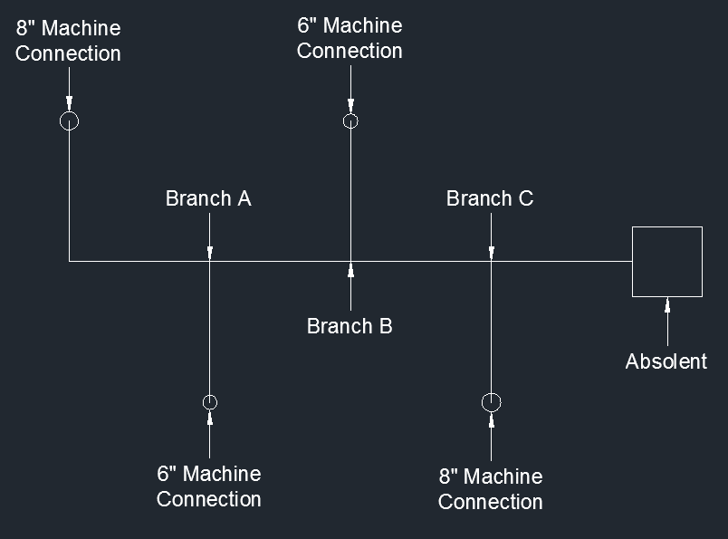
Sizing Duct Layout Example 2
Example: Design the duct layout for below layout. Please note the below line drawing is taken in the plan view.

Slide 14
Sizing Duct Layout Example 1 – Branch A
CFM_{8”}= 3000FPM * SA_{8”}
CFM_{8”}= 3000FPM * .3491ft²
CFM_{8”}= 1050CFM
CFM_{6”}= 3000FPM * SA_{6”}
CFM_{6”}= 3000FPM * .1964ft²
CFM_{6”}= 590CFM
CFM_{Branch A} = 590CFM + 1050CFM
CFM_{Branch A} = 1640CFM
FPM_{Oil Mist} = 3000FPM
CFM=FPM*SA
1640 CFM = 3000FPM * SA
1640/3000 = SA = .546ft²
.546ft² is closest to .545ft² = 10” duct
Branch A is 10”x8”x6”

Slide 15
Sizing Duct Layout Example 1 – Branch B
CFM_{6”}= 590CFM
CFM_{Branch B} = 1640CFM + 590CFM
CFM_{Branch B} = 2230CFM
FPM_{Oil Mist} = 3000FPM
CFM=FPM*SA
2230 CFM = 3000FPM * SA
2230/3000 = SA = .743ft²
.743ft² is closest to .785ft² = 12” duct
Branch B is 12”x10”x6”

Slide 16
Sizing Duct Layout Example 1 – Branch C
CFM_{8”}= 1050CFM
CFM_{Branch B} = 2230CFM + 1050CFM
CFM_{Branch B} = 3280CFM
FPM_{Oil Mist} = 3000FPM
CFM=FPM*SA
3280 CFM = 3000FPM * SA
3280/3000 = SA = 1.093ft²
1.093ft² is closest to 1.069ft² = 14” duct
Branch C is 14”x12”x8”

Slide 17
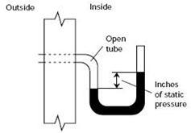
Static Pressure
Static Pressure (SP) is the buildup of pressure throughout a duct run
Every piece of pipe/transition/fume arm/collector exerts some type of SP on the system
SP is cumulative – you calculate the largest static pressure drop in the system and base your calculations off of that figure
Fan performance is dictated by the SP of the system. If the system exerts less SP on the fan then the fan is rated for, the fan will perform at designed performance
Conversely, if the system exerts more pressure on the fan then the fan is designed for, the fan will perform at a less than optimal performance

Slide 18
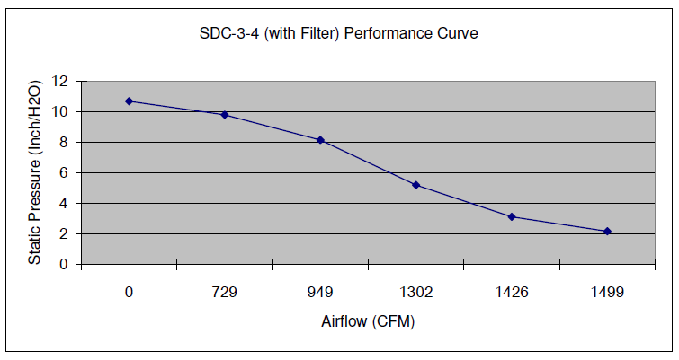
Static Pressure Example:SDC-3-4
See SDC-3-4 Performance Curve
The SDC-3-4 advertises to be 1500 CFM collector
Compare the CFM of the collector with Static Pressure at 2”, 4”, 6”, and 8”
2” SP = 1500 CFM
4” SP = 1360 CFM
6” SP = 1125 CFM
8” SP = 949 CFM

Slide 19
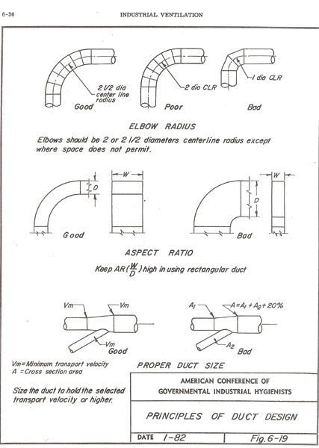
Static Pressure – How to Reduce
Elbows
Using 2.5D or 1.5D radius elbows instead of 1-D
Branches
Using branches that come in at 45º or 30º angles instead of 90º angles (T’s)
Reducers
Using slow-reducing reducers instead of quick reducers
Straight Pipe
Use proper transport velocities instead of fast velocities when not required
IF you have to calculate…

Slide 20
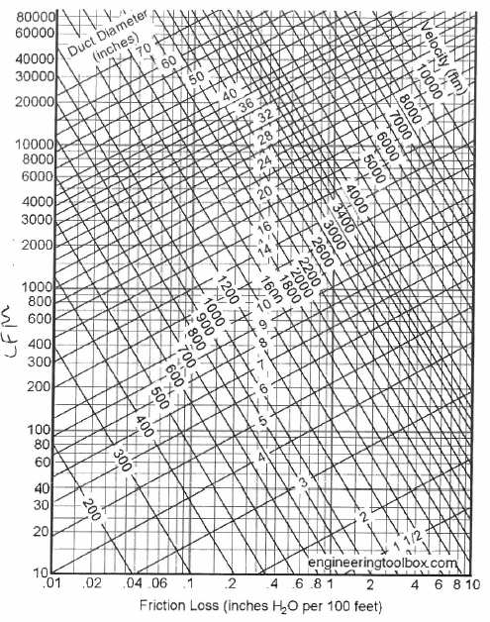
Static Pressure Calculations
In straight pipe
Find two of three variables below:
CFM
Velocity in Duct
Diameter
Find where they intersect on chart
“x” run denotes friction loss per 100 ft
In branches/elbows
Using online formulas, find “k” factor
Calculate velocity pressure using formula below:
V_{p}=(V_{duct}/4005)^2
SP = V_{p}*K

